Slide 1
TPP Defense Summit
Digital Transformation Panel Discussion
Kenneth Senechal
Senior Technical Advisor
KBR
Test Resource Management Centerer Digital Engineering Team

Slide 2
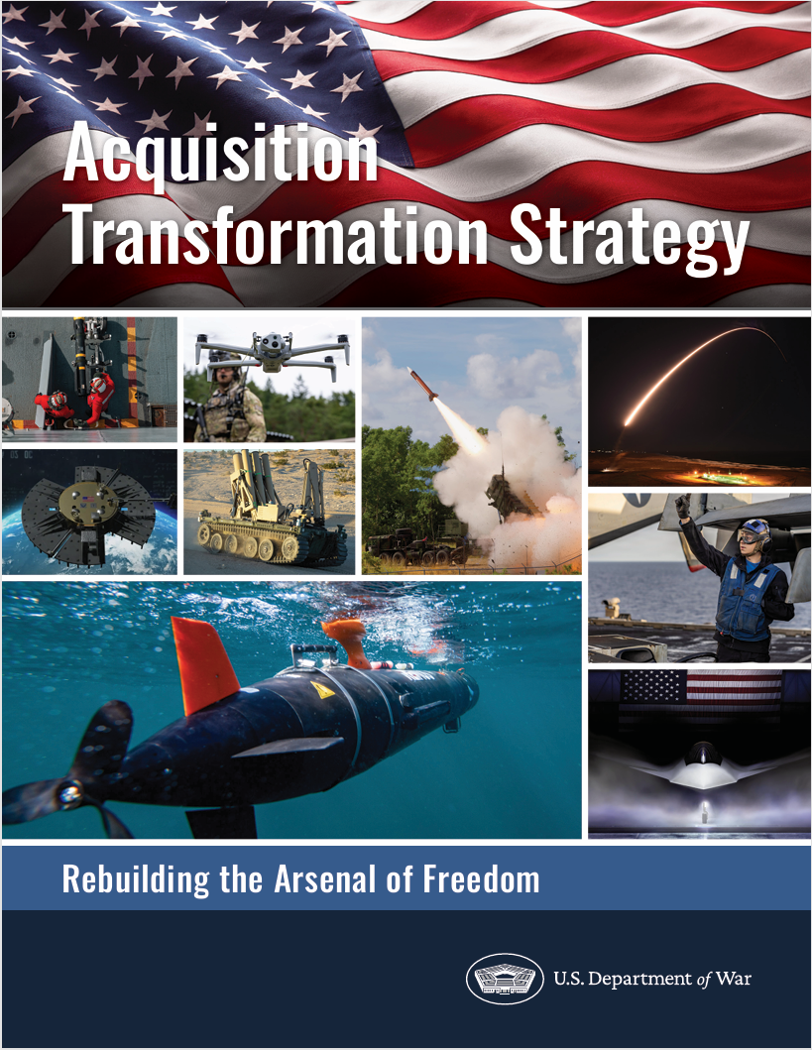
Acquisition Transformation
Capability Portfolio Management Review (CPMR)
Integrated Acquisition Portfolio Review (IAPR)
Technology Modernization Transition Review (TMTR)

Slide 3

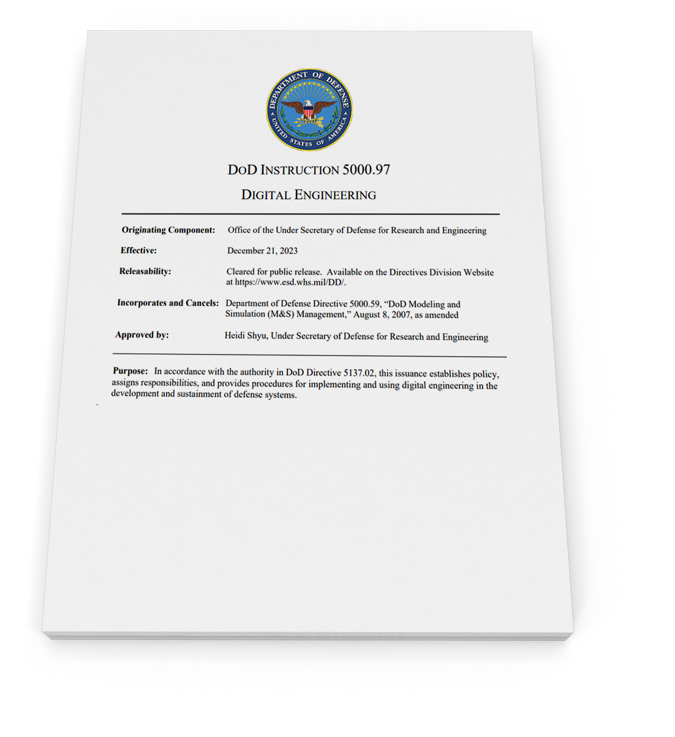


Digital Engineering Guidance
DODI 5000.97 –
Digital Engineering
Guidance per OUSD (R&E)
Effective December 21, 2023
Section 1.2 Policy (in part):
DoD will use digital engineering methodologies, technologies, and practices across the life cycle of defense acquisition programs, systems, and systems of systems to support research, engineering, and management activities.
Section 2.2 Responsibilities:
Director, DoD Test Resource Management Center (TRMC)
a. Develops and maintains a core DoD-wide digital engineering infrastructure capability, methodologies, and practices to support acquisition programs.
b. Develops and maintains the methodology for distributed developmental testing which may be necessary to support digital engineering capabilities.
Section 3.1 Digital Engineering:
Digital engineering is a means of using and integrating digital models and the underlying data to support the development, test and evaluation, and sustainment of a system.
“ .. critical practice necessary to support acquisition and sustainment in an environment of increasing global challenges, complexity, dynamic threats, rapidly evolving technologies, supply instability, and increasing life expectancy of DoD systems currently in operation.”
“ .. enable faster, smarter, data-driven decisions throughout the system life cycle. Digital engineering should enable faster, higher-quality decision making in weapon system design, development, testing, fielding, and sustainment.”
“.. enable more rapid delivery of warfighting capabilities to the field.”
Act on
Guidance & Vision
to enable Outcomes
FULL DOCUMENT PDF
External Link

Slide 4
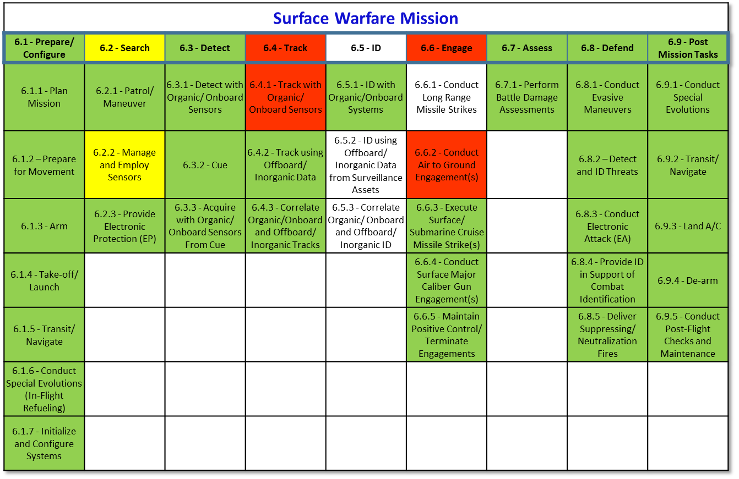
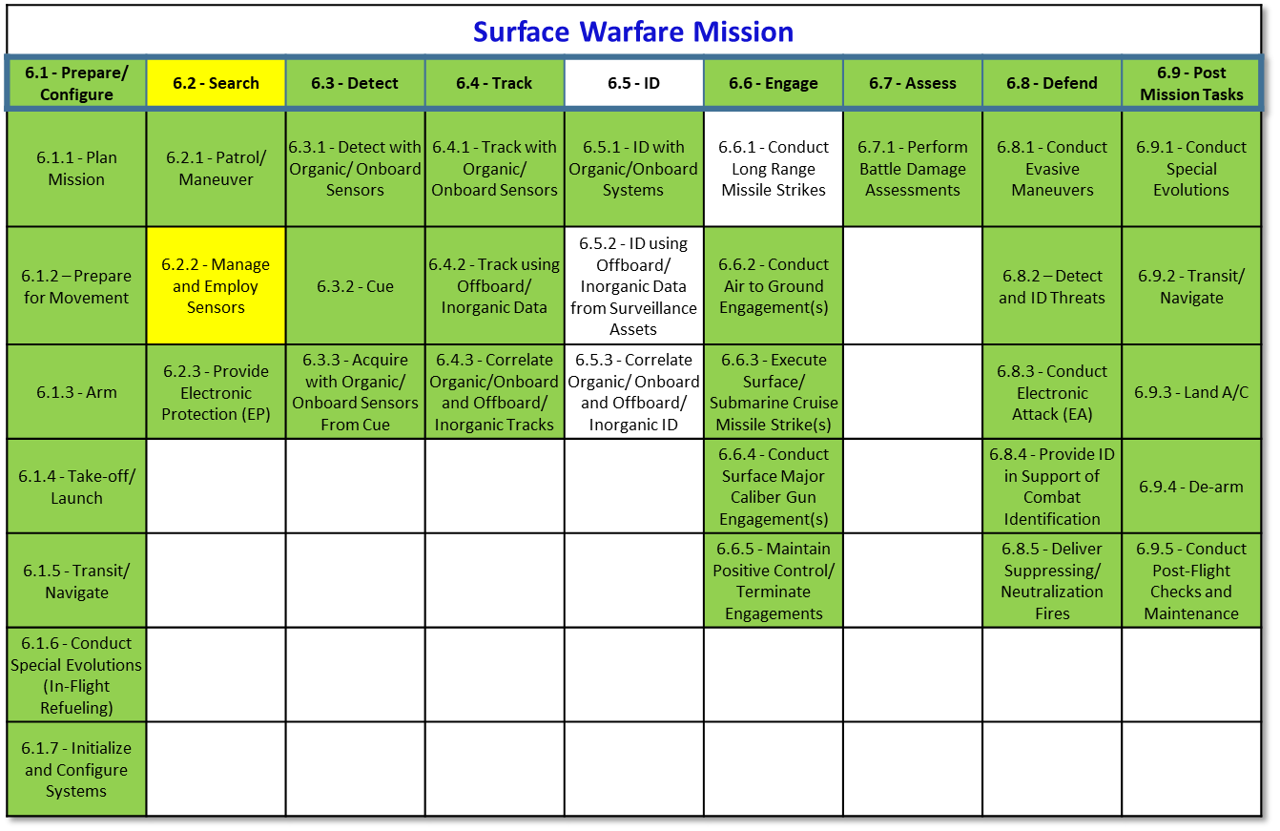

Decision Support Across the Capability Delivery Continuum
Decision Support Enterprise Framework
Decision Space
Operational, Technical, Acquisition
Mission Thread
Mission Engineering
S&T
Prototyping/ Experimentation
Acquisition
Pathways
(Including MTA RP/RF)
Production/Fielding
Sustainment
Capability Lifecycle
Technical Validation
This will include conducting and assessing operational utility at joint rehearsals, exercises, and/or other relevant maturation events; as well as conducting continuous operational assessments of programs, systems, and prototypes to provide sound recommendations to senior Department leadership.
Early Capability Validation
Design Validation
Capability Validation
Learning Systems/Agile Software Systems Validation
(Inform Requirements) Feedback Cycle (Validate Assumptions)
T&E as a Continuum
“T&E Enterprise as an Integrator – Disciplined Approach to Collecting Data”
M&S
“Continuous Validation to Inform Risk” Drives
Concept Development/Requirements Development/Analysis Support
V&V
Engineering models
Subcomponent + Surrogates
Subsystem Models
Digital Twins + Surrogates
System Models + Integration into SOS Architecture + Surrogates
MDO/FoF/Campaign
Models
M&S as a Continuum
Digital Thread(s) across Capability Lifecycle
Simulation Environments
“Authoritative Source of Truth” Requires
Physics & Process (MBSE) Models
Shared Body of Knowledge (Continuous Data)
Data Transparency/Knowledge Management/CCE (Cloud Computing Environment)

Slide 5
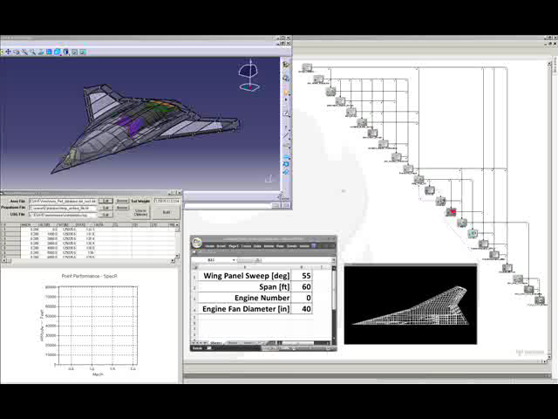

ESAVE MDAO Model Animation
Blending ME/SE/T&E
CATIA Model
Model Center
N^2 Chart
Sky Map
Nastran Grid
Approved for public release; NG19-0290

Slide 6














Capability Portfolio Management
*Chart NOT updated to reflect latest policy/guidance
Technology Modernization Transition Review
(TMTR)
S&T transition timelines
Technology Acceleration Opportunities
Joint Requirements Oversight Council
(JROC)
Capability
Gaps
Performance
Gaps
(Re)Prioritization and Validation of Requirements
New Technology
Program Requirements Recs
Operational
Needs
Integrated
Acquisition Portfolio
Review
(IAPR)
Acquisition
Recs
“the Warfighting Acquisition University (WAU)… institutionalize a modernized training methodology that emphasizes immersive, scenario-based experiential learning focused on portfolio management competencies.”
Capability
Portfolio
Mgmt Review (CPMR)
Capability Gaps
Acquisition Decisions
Capability
Needs
Defense Acquisition
System
(DAS)
Roadmaps
Output(s)
Investment Prioritization and Reprogramming
+
+
=
Resourcing Recs
Operational Needs and Mission Context
Force Structure
Timescales
Mission Threads
Operational Capability Gaps
Capacity Needs
Acquisition and Sustainment Health
Capability Maturity
Enabling Programs/Systems
Programmatic Gaps
Planning, Programming, Budgeting, and Execution System
Implementation Opportunities Enabled by CPM
Decision Support – Trade Space Analysis
Golden Forge – Digital Engineering Platform / Tool/Data/Methods/Practices

Slide 7
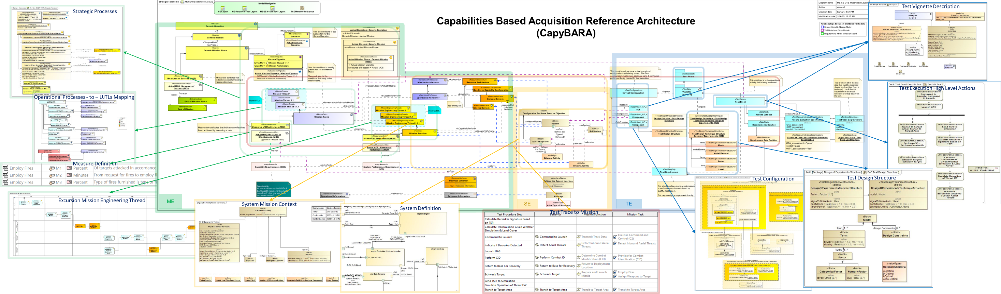
Capabilities Based Acquisition Reference Architecture
Execute Mission Engineering
Use version of OUSW-RE Mission Integration’s Operation Desert SEAD example
Developed mission & mission engineering threads and concept system definition
Develop System Based on Mission Needs
Applied notional hypersonic missile deployment vehicle. MQ-99 Berserker, developed by MTSI to SEAD Mission
Developed subsystem with Cyber Schema attributes, internal connectivity, activities allocated
Perform Mission Based Test Design
Selected vignette, “Employ Fires,” and built test case, configuration, DOE to evaluate Measures of Effectiveness
Define evaluation criteria, data collection, validation constraints, logging
Used existing Test Resources Library to specialize needed test configuration components
Capabilities Based Acquisition Reference Architecture (CapyBARA)

Slide 8
Backups

Slide 9
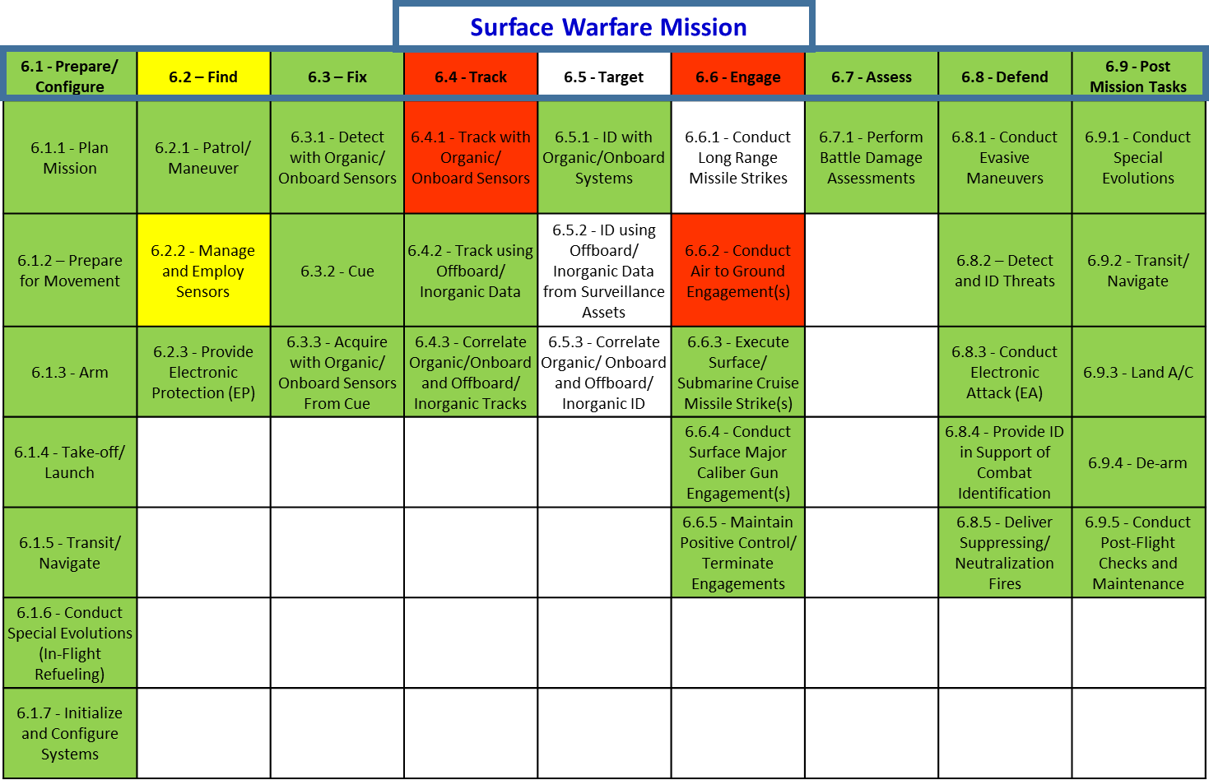
Mission Reporting Dashboard (Conceptual)

Slide 10
ME / SE / T&E linked
SE
Surface Warfare Mission
TASKS
Prepare/Config
Find
Fix
Track
Target
Engage
Assess
Defend
Post Mission Tasks
Measures
M34
M74
M75
M76
M83
M84
M89
M90
M91
M93
Conditions
M73
M28
M30
M31
M32
M88
M92
M94
C1.3.1.3.4
C1.3.1.3.6.1
C1.3.1.3.6.2
C1.3.1.3.7
C1.3.1.3.9
C4.9
C4.12
C4.19
C4.22
C1.2.1.3
C1.3.1.3.6.1
C1.3.1.3.6.2
C1.3.2.1
C4.22
C4.38
C4.44
C4.46
C4.50
C4.51
Design Reference Mission
Mission Test Vignettes
Track-Ex
Target-Ex
Engage-Ex
Contractor Test /
Developmental Test / Experimentation
System Function / Decomposition
Mission Aligned Continuum of Test

Slide 11
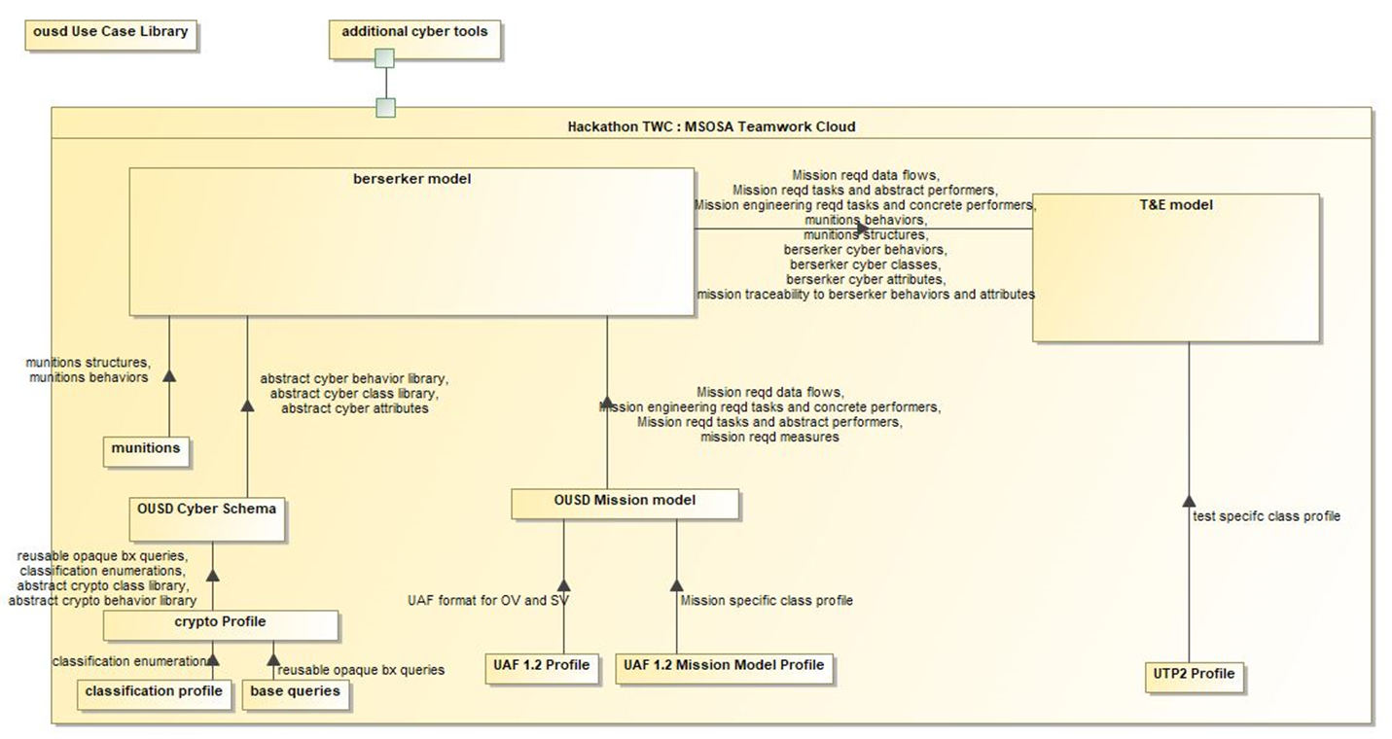
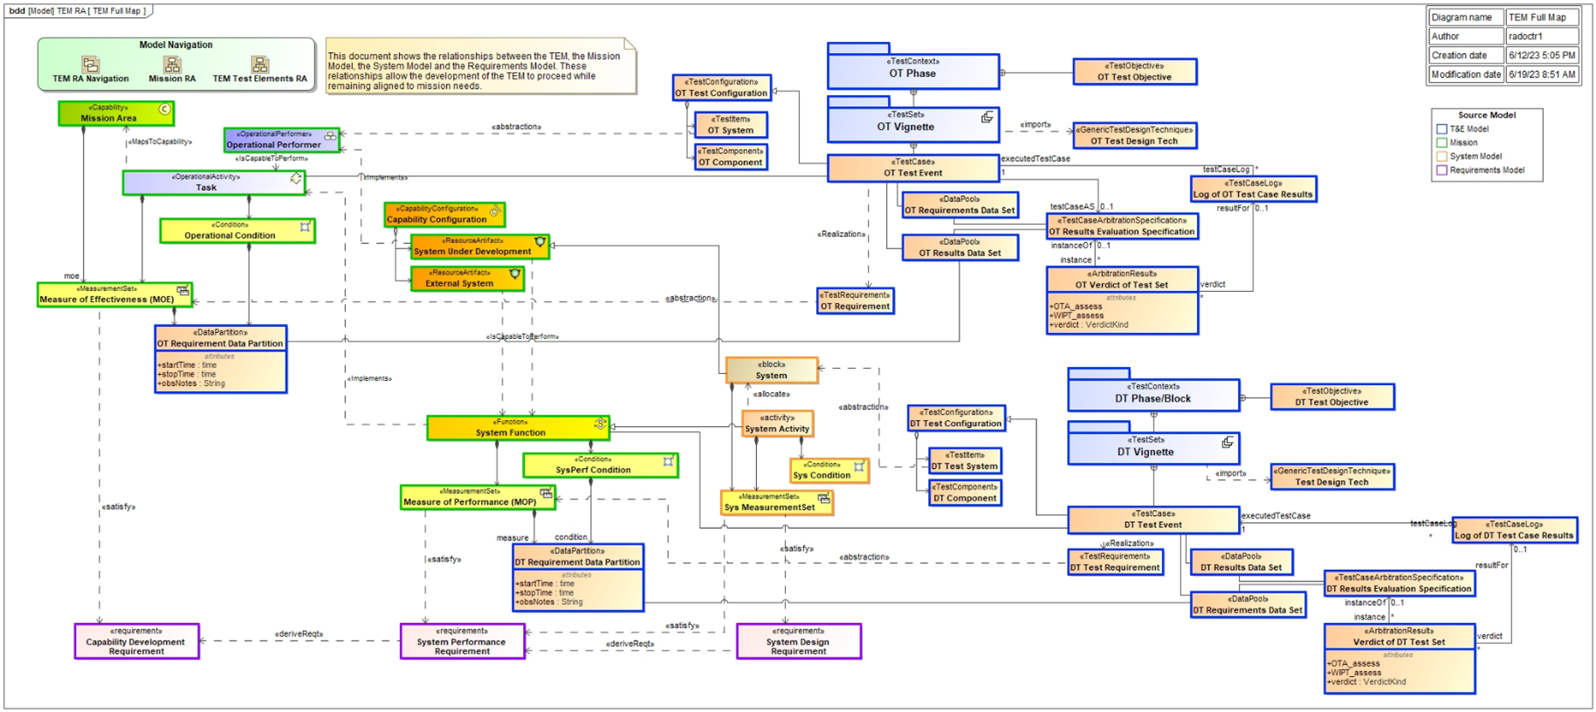
DTE&A Hosted Hackathon
Turning the Concept Into Reality
  Over 200 in person participants from OUSW, Services, Industry, and Academia
  Accelerated learning environment
  Linked together Mission Engineering / Systems Engineering / T&E in a Digital Engineering Ecosystem
  Dedicated Cyber Deep Dive

Slide 12
Top Level Architecture

